Slide 1
Programming with B4X
Lesson 6 – From Designer to Code
Anywhere Software
Feb 2021

Slide 2
Today you will learn
Class_Globals
Variables and Subs
Passing Values to Code
Events
Attributes
Notes:
Designing the app's appearance in Designer is the first step in the manufacturing stages. Often new developers turn to it to redesign, correct, or add individual information.
When the screen is ready the developer goes to the next stage of programming the functions. That is, everything that elements included in the design to gain functionality. In other words, text boxes can record data, buttons can activate functions, lists can display data, etc.

Slide 3
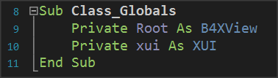

Class_Globals
Routine
You can Declare Variables inside this sub
Notes:
At the beginning of the code on tab B4XMainPage there is a set of variable declarations between Sub Class_Globals and End Sub.
As it has already been said in 3rd Lesson Sub is a set of code that performs a specific operation. The operation of the Class_Globals is to collect the declarations of variables that we want to be known throughout the code of the tab B4XMainPage, i.e. in each subprogram.
In addition, if a variable statement starts with the public it will be available from other program "tabs".

Slide 4
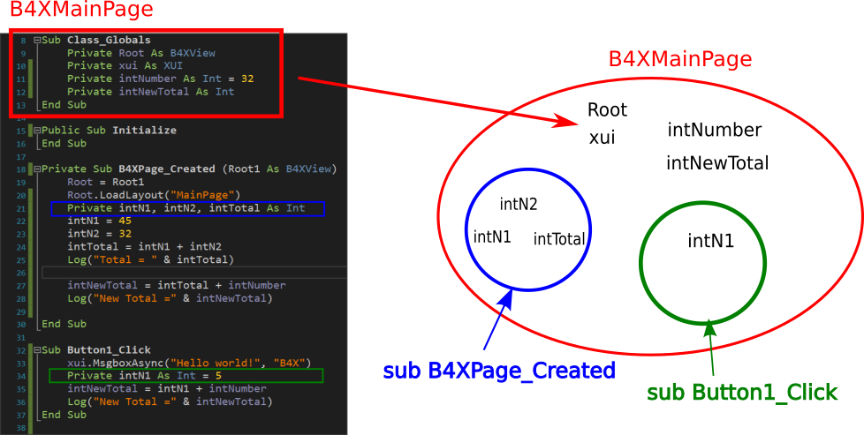
A deeper look at the use of variables.
Notes:
The intNumber, intNewTotal, Root, and xui variables declared within Class_Globals "live" within Module B4XMainPage.
On the contrary, variables intN1, intN2, intTotal 'live' within the sub-program B4XPage_Created and for this reason No another subprogram may use them. At the same time, the variable intN1 who lives in the Button1_Click is not the same with the one in B4XPage_Created, both has its own memory space, and both can have the same name.

Slide 5
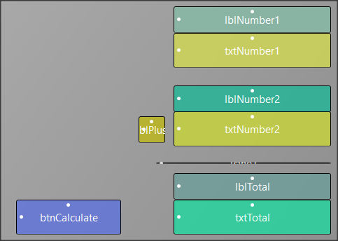
Passing Values to Code
Declare txtNumbers in your Code
Declare Button in your Code
Notes:
In the previous lesson’s example, some of the objects on the screen do not have to be included in the code.
So, all "labels" items in this application do not have to be managed by code as well as the pane element. While button and textFields must be added to schedule functions on them.
There are two ways to insert your objects into the code.

Slide 6
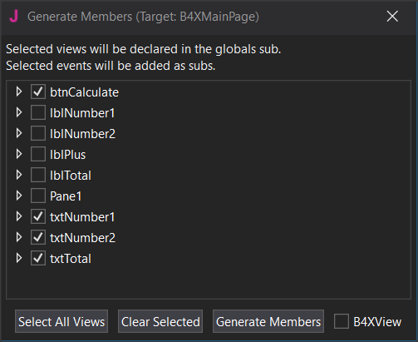
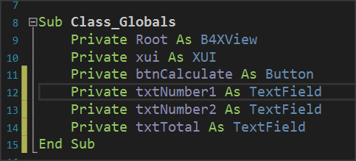
Generate Members
Each object we import is of a certain type as well as the types of variables.
Notes:
In Screen Generate Members just click on objects
• btnCalculate
• txtNumber1
• txtNumber2
• txtTotal
and then click Generate Members. Your code in the Class_Globals subprogram will be updated automatically with the variables.
The second input solution is to write the variables yourself, paying attention so that the names of the objects on your screen are the same as those you write as a variable.

Slide 7
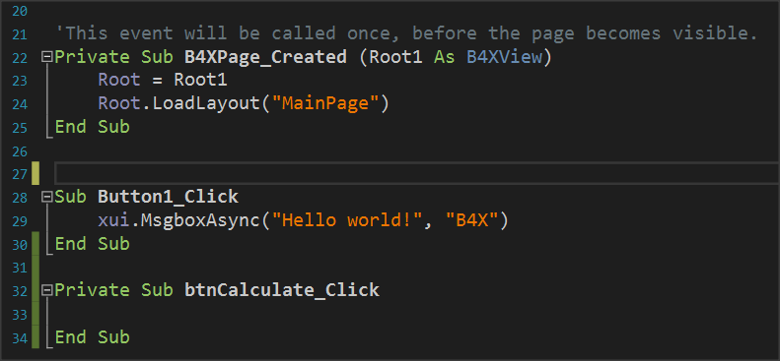
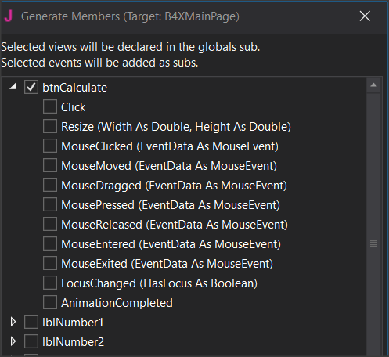
Events
There are hundreds of different events happening in one application; the developer determines how the program will react to each of them.
There are hundreds of different events happening in one application; the developer determines how the program will react to each of them.
Notes:
After you have declared the variables of objects, the final stage is to enable the functions of the form.
This depends on how you've decided that each app works. In the example with the two numbers there is a button called Calculate and it is what will activate the addition as well as the appearance of the result on our screen.
The operation is triggered by a process called "Event. The programmer must detect the event of pressing the key Calculate and when this is done then do the relevant calculations and display the result.

Slide 8
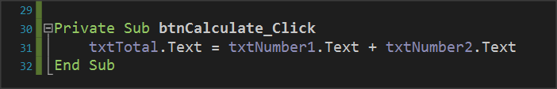
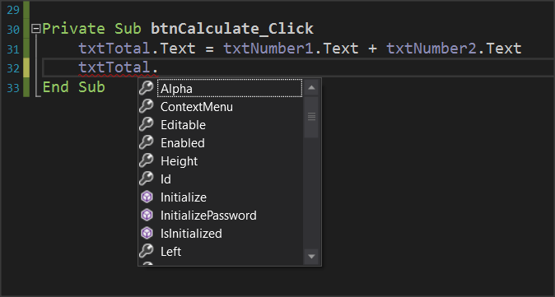
Programming Events
The content of textField txtTotal is equal to the contents of txtNumer1 and txtNumber2.
Notes:
Within an Event subprogram, all the functions associated with it are usually performed.
Essentially both are achieved with a single command. Each object you insert into your code has a number of different properties. For example properties can be the color, size, location content as they have been Described and in the previous lesson. These properties can provide information or change display issues. For example, the property txtNumber1.text provides information on the content of the object txtNumber1 or can set a value as content depending on how you use the. This information is type string.

Slide 9
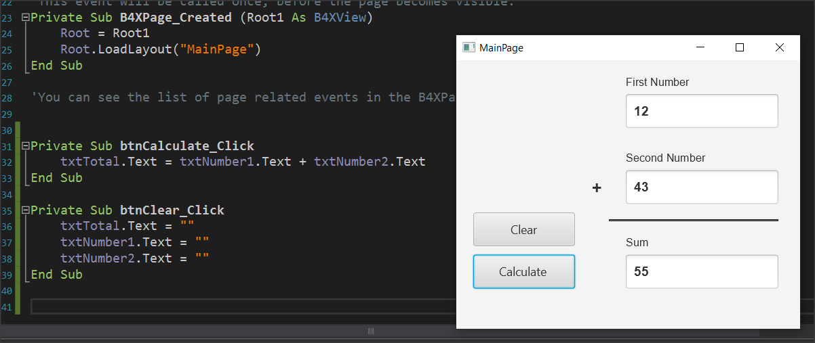
Create new Events
Open Designer and add a new button named e.g. btnClear
Set it as a variable in Class_Global
Enter the event btnClear_Click
Set the text properties of txtNumber1, txtNumber2, txtTotal to ""

Slide 10
Thank you!!!
Photos taken From:

